Slide 1
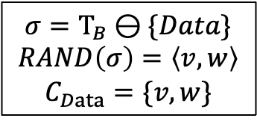



Auditor
Server
Client
Auditor
$${ C}_{Data}$$
$$Τ_{B}=SIGN(B)$$
B
$$Data/⊥=AUTH\left(B,C_{data}\right)$$
$$σ=Τ_{B}⊖\{Data\}$$
$$RAND\left(σ\right)=\left\langle v,w\right\rangle$$
$$C_{Data}=\{v, w\}$$
Auditor

